Slide 1

Group Members:
Name, UID
Name, UID
Name, UID
Name, UID
Placement management system

Slide 2
Problem Statement
The purpose of the project “WEB BASED PLACEMENT MANAGEMENT SYSTEM USING CERTIFICATE AUTHENTICATOR”, the manual work makes the process slow and other problems such as inconsistency and ambiguity on operations. In order to avoid this web-based placement managed system is proposed, where the student information in the college with regard to placement is managed efficiently. It intends to help fast in fast access procedures in placement related activities and ensures to maintain the details of the student. Students logging should be able to upload their personal and educational information. The key feature of this project is that it is one-time registration enabled. The placement cell calls the companies to select their students for jobs via the campus interview. The placement cell allows the companies to view the student resumes in selective manner. They can filter the students’ profile as per their requirement. The job details of the placed students will be provided by the administrator.

Slide 3
Road Map
Postman
Controller Layer
Service Layer
Repository Layer
Database
Application will be developed in following Sprints –

Slide 4
Plan
Design
Generate the skeleton as per class design provided
TDD approach
Identify test cases for each module
Write Failing Test cases
Convert the Test Cases in GREEN
Implement the case study in incremental manner

Slide 5
Modules
Login Module:
All university and corporate must login into the website to view student information, placement schedule information. All user names and password must be protected by using this module, which means that for each user, there must be unique username and password.
Student process module:
In this module,
University can post new student data by giving the following information,
Student name
Qualification
Course
Year of passing
Certificate
Corporate can download the certificate of a particular candidate by giving following information
Student name
Hal ticket number
Search module:
In this module corporate can search for candidate information. The search process is working based upon the search string, which is related to name or hall ticket number.
Placement schedule module:
In this module corporate can schedule a campus placement in particular university by giving the following information
Schedule date
Qualification
Year

Slide 6
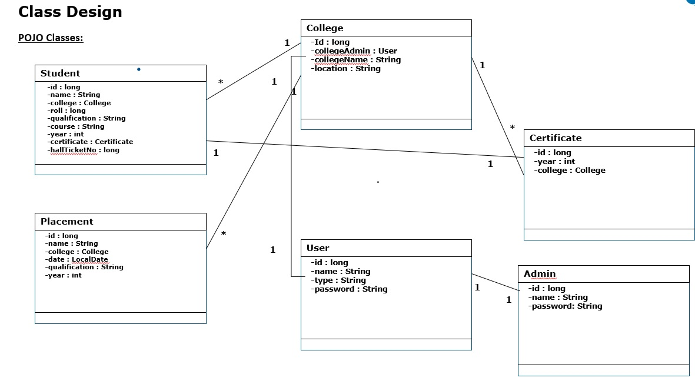

Slide 7
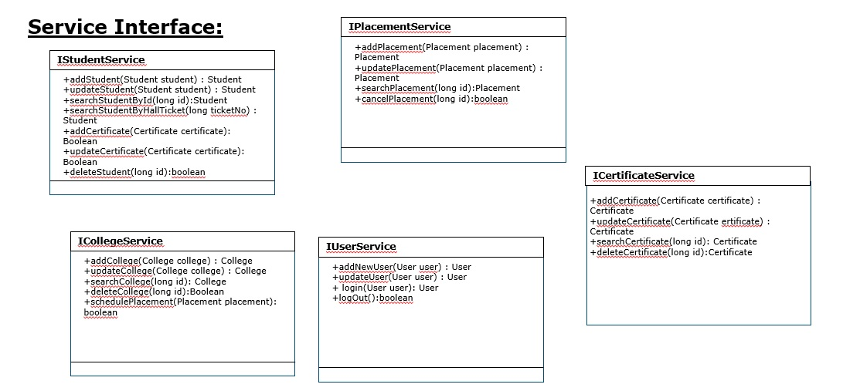

Slide 8
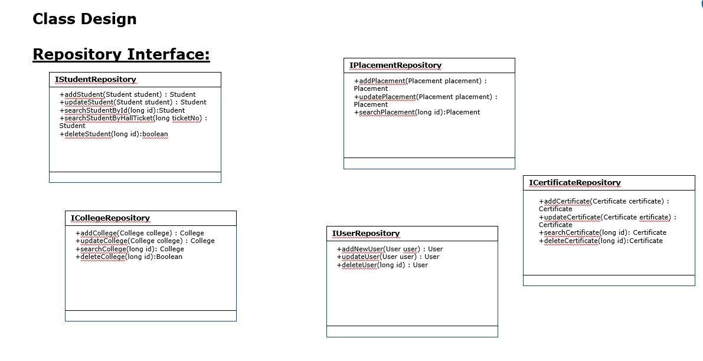

Slide 9
Group Members:
Name, UID
Name, UID
Name, UID
Name, UID
Shopping mall management system

Slide 10
Problem Statement
In this project, we will be designing a simple shopping mall management system. The mall will provide a soothing shopping experience for customers, provide mall management functions to mall administrators and inventory/staff management to shop owners at the mall.
Mall Administrator:
The Mall Administrator is the super user and has complete control over all the activities that can be performed. The application notifies the administrator of all shop creation requests, and the administrator can then approve or reject them. The administrator can check the floor plan to see all the shops in the mall. The administrator can also get details about the mall employees.

Slide 11
Road Map
Postman
Controller Layer
Service Layer
Repository Layer
Database
Application will be developed in following Sprints –

Slide 12
Plan
Design
Generate the skeleton as per class design provided
TDD approach
Identify test cases for each module
Write Failing Test cases
Convert the Test Cases in GREEN
Implement the case study in incremental manner

Slide 13
Modules
Login Module:
All users/admins should provide valid credentials to assess the system. Credentials will contain a unique userId and password. New user can signup to this system.
Shop module:
In this module,
Create new shop
Add new customers to shop
Remove Customers
Manage Employees
Add/Remove Sub-Categories
Admin Module
In this module mall admin can
Approve/Reject pending shop creation requests
Manage Guest Book
Send Notifications to shop owners
Customer module:
In this module customer can
Browse Customers
Manage Orders
Make Payment
Add/View Guest Book

Slide 14
Modules
Login Module
Customer Module
Shop Management Module
User Management module
Mall Mangement
Module
Guest Book Management
Module
Cart Management module
Order Management module

Slide 15
Class Design
Item
Mall
*
-id : long
-name : String
-manufacturing : LocalDate
-expiry: LocalDate
-price: float
-category: String
-Id : long
-mallAdmin : MallAdmin
-mallName : String
-location : String
-shops_id: Shop
-categories: String
POJO Classes:
1
Shop
-shopId: int
-shopCategory: String
-shopEmployeeID: Employee
-shopName: String
-customers: String
-shopStatus: String
-shopOwner: ShopOwner
-leaseStatus: String
1
OrderDetails
1
-id : int
-dateOfPurchase: LocalDateTime
-total: float
-customer_id: Customer
-paymentMode: String
-shop_id: Shop
*
1
User
Customer
1
-id : int
-name : String
-type : String
-password : String
1
-id : int
-name : String
-order_id : OrderDetails
-phone: String
-email: String
1
Employee
-id : int
-name : String
-dob : LocalDate
-salary: float
-address: String
-designation: String
-shop_id: Shop
1
*
1
MallAdmin
1
ShopOwner
-id : int
-name : String
-password: String
-mall: Mall
-phone: String
-id : int
-name : String
-dob : LocalDate
-address: String
-shop_id: Shop

Slide 16
Class Design
Service Interface:
IShopService
IOrderService
ICustomerService
+addShop(Shop shop) : Shop
+updateShop(Shop shop) : Shop
+searchShopById(long id):Shop
+addEmployee(Employee employee): Boolean
+updateEmployee(Employee employee): Boolean
+deleteShop(long id):Boolean
+addItem(Item item):Item
+addOrder(Order order) : Order
+updateOrder(Order order) : Order
+searchOrder(long id):Order
+cancelMall(long id):boolean
+addItem(Item item):Item
+searchItem(String itemName) : List<Item>
+orderItem(Item item) : Item
+searchMall(long id):Mall
+cancelOrder(long orderId):Boolean
+ login(User user): User
+logOut():boolean
IEmployeeService
IAdminService
+addEmployee(Employee employee) : Employee
+updateEmployee(Employee employee) : Employee
+searchEmployee(long id): Employee
+deleteEmployee(long id):Boolean
+approaveNewShop(Shop shop) : Boolean
+updateUser(User user) : User
+ login(User user): User
+logOut():boolean
IUserService
+addNewUser(User user) : User
+updateUser(User user) : User
+ login(User user): User
+logOut():boolean

Slide 17
Class Design
IMalltRepository
IOrderRepository
+addMall(Mall mall) : Mall
+updateMall(Mall mall) : Mall
+searchMall(long id):Mall
+addOrder(Order order) : Order
+updateOrder(Order order) : Order
+searchOrder(long id): Order
+deleteOrder(long id):Order
Repository Interface:
IShopRepository
+addShop(Shop shop) : Shop
+updateShop(Shop shop) : Shop
+searchShopById(long id):Shop
+deleteShop(long id):boolean
ICustomerRepository
+addCustomer(Customer customer) : Customer
+updateCustomer(Customer customer) : Customer
+searchCustomer(long id): Customer
+deleteCustomer(long id):Customer
IShopOwnerRepository
+addShopOwner(ShopOwner shopOwner) : ShopOwner
+updateShopOwner(ShopOwner shopOwner) : ShopOwner
+searchShopOwner(long id): ShopOwner
+deleteShopOwner(long id):ShopOwner
IEmployeeRepository
+addEmployee(Employee employee) : Employee
+updateEmployee(Employee employee) : Employee
+searchEmployee(long id): Employee
+deleteEmployee(long id):Boolean
IMallAdminRepository
+addMallAdmin(MallAdmin mallAdmin) : MallAdmin
+updateMallAdmin(MallAdmin mallAdmin) : MallAdmin
+searchMallAdmin(long id): MallAdmin
+deleteMallAdmin(long id):MallAdmin
IItemRepository
IUserRepository
+addItem(Item item) : Item
+updateItem(Item item) : Item
+searchItem(long id): Item
+deleteItem(long id):Item
+addNewUser(User user) : User
+updateUser(User user) : User
+deleteUser(long id) : User

